Slide 1

E-commerce Shopping Website
Syed Mehdi Raza 20K-0447
Syed Haziq Ahmed 20K-0227
Masab Bin Fakhar 20K-0123

Slide 2

Introduction
Describing and defining the specifications and functionalities of our E-Commerce System is the primary goal of this Software Requirements Specification (SRS). This Software Requirements Specification illustrates, in clear terms, the system’s primary uses and required functionality.

Slide 3
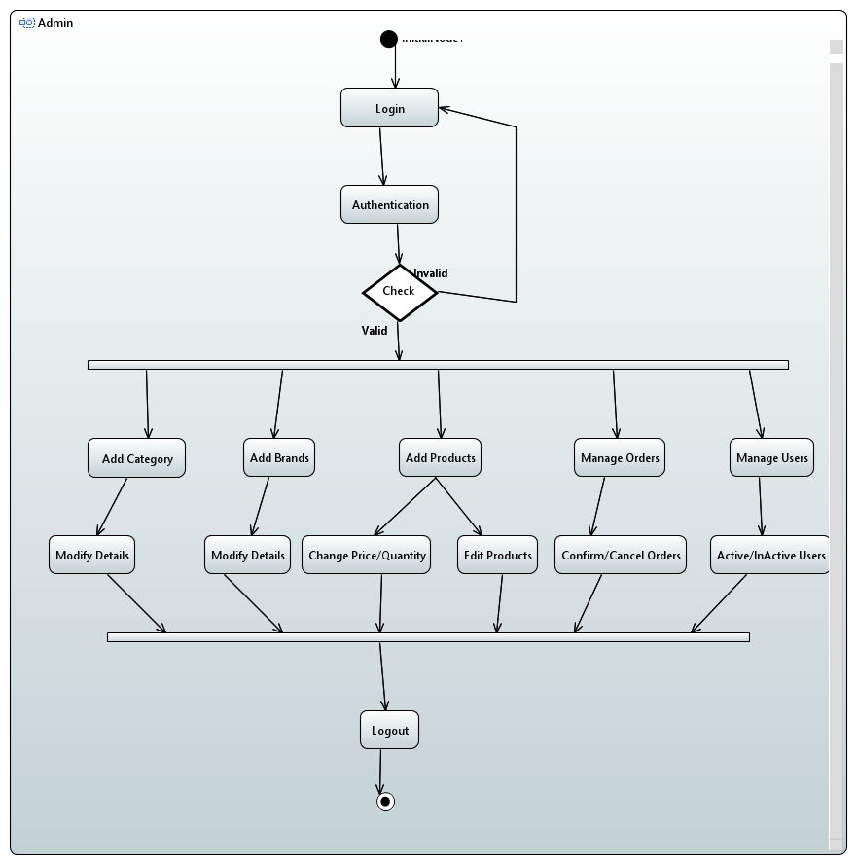
Activity Diagram

Slide 4
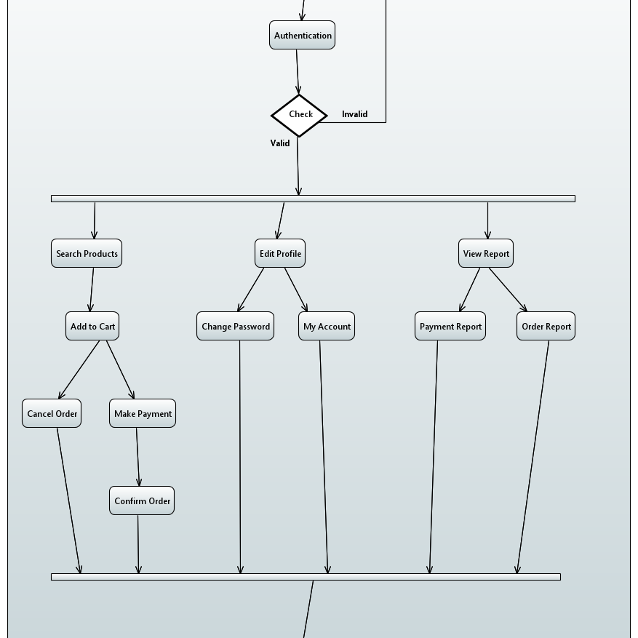
Activity Diagram

Slide 5
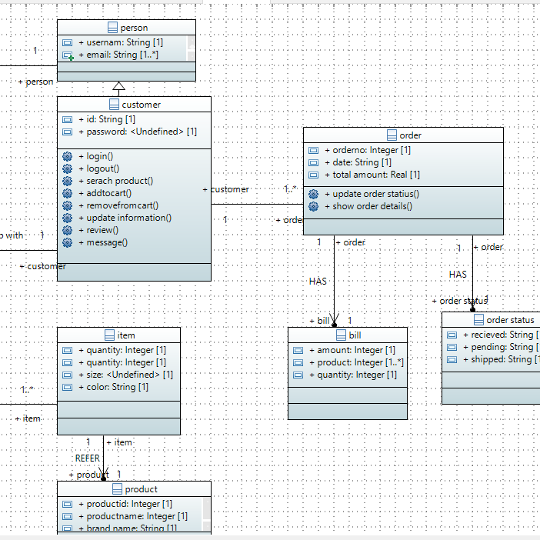
Class Diagram

Slide 6
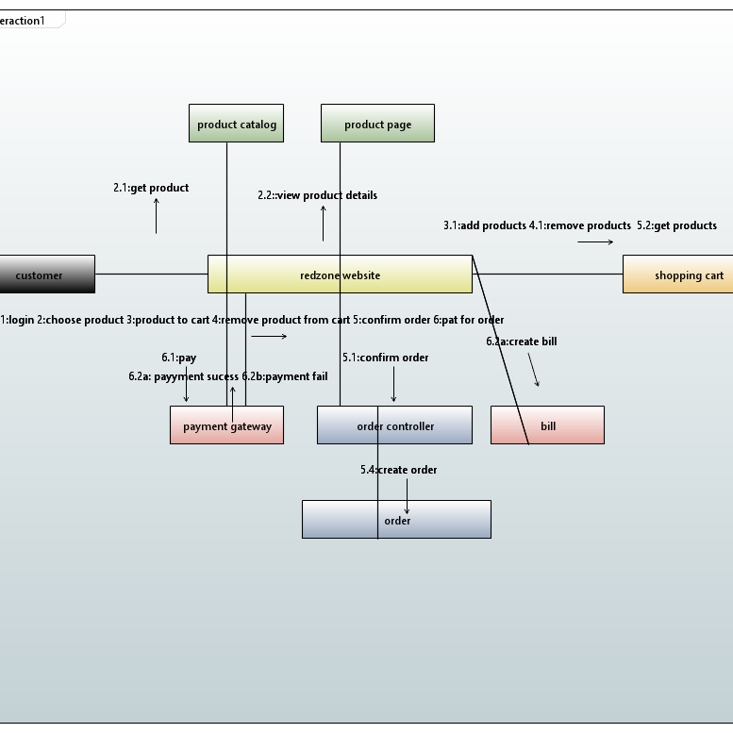
Communication Diagram

Slide 7
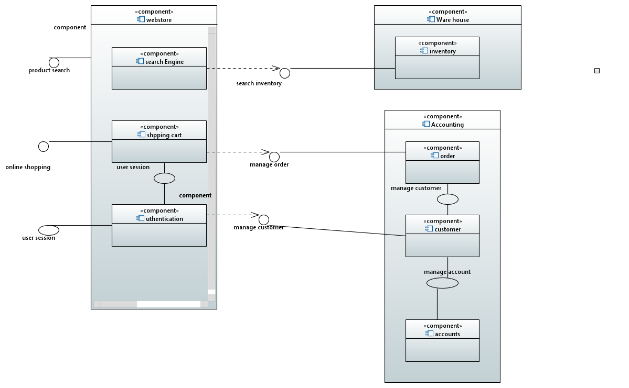
Component Diagram

Slide 8
Component Diagram

Slide 9
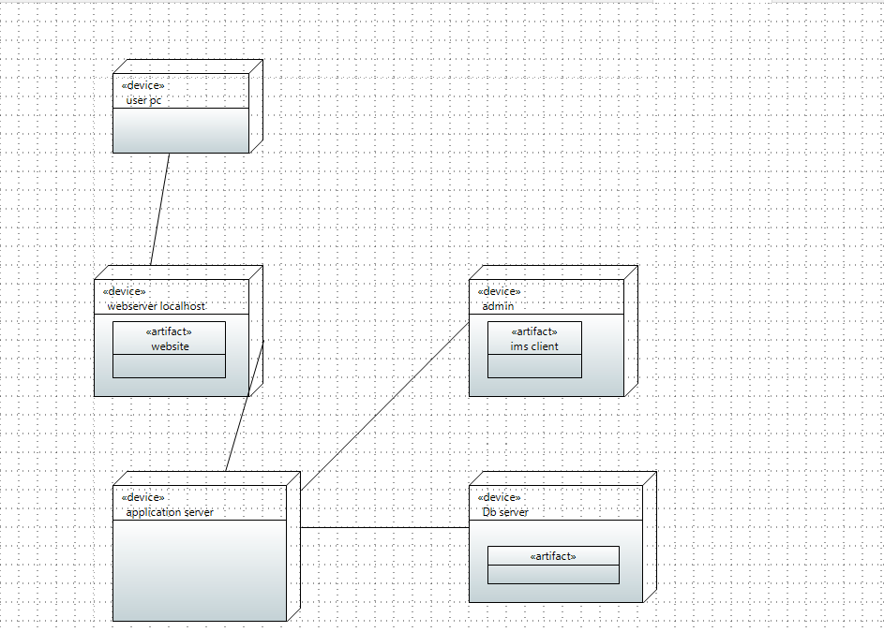
Deployment Diagram

Slide 10
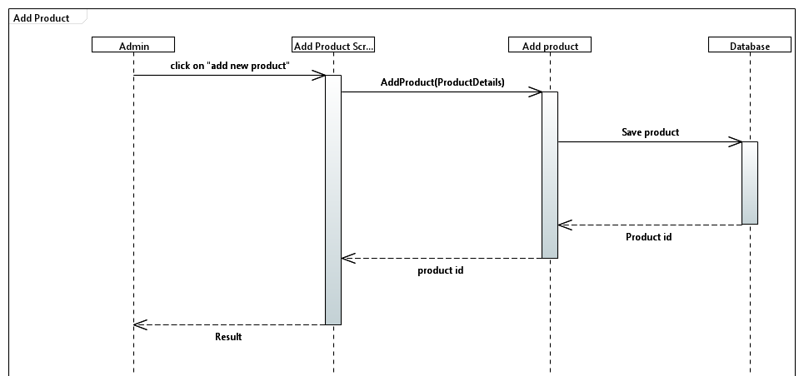
Sequence Diagram

Slide 11
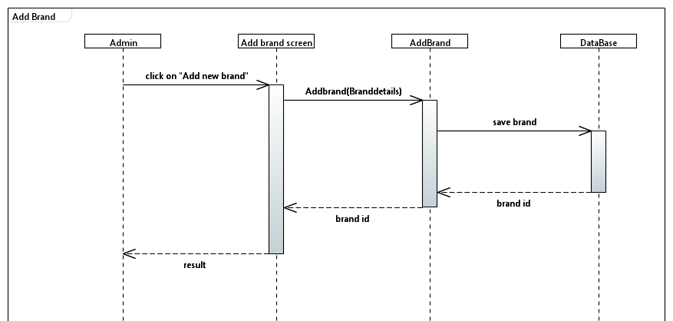
Sequence Diagram

Slide 12
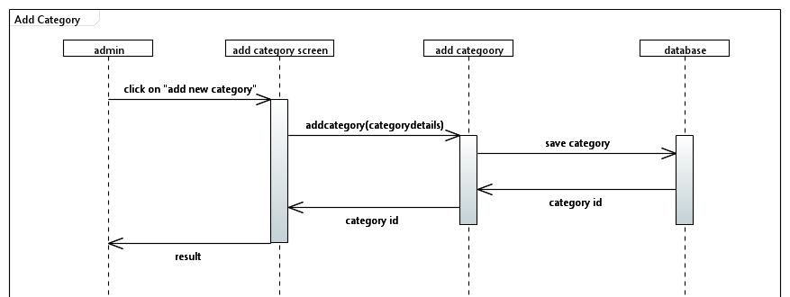
Sequence Diagram

Slide 13
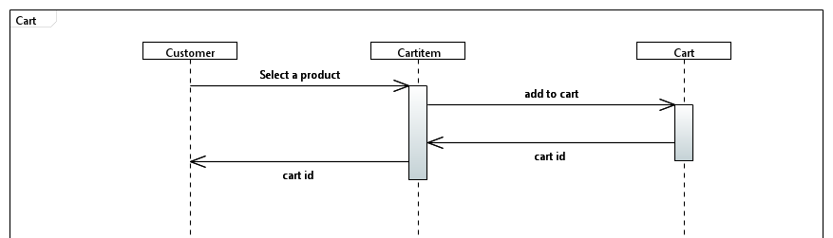
Sequence Diagram

Slide 14
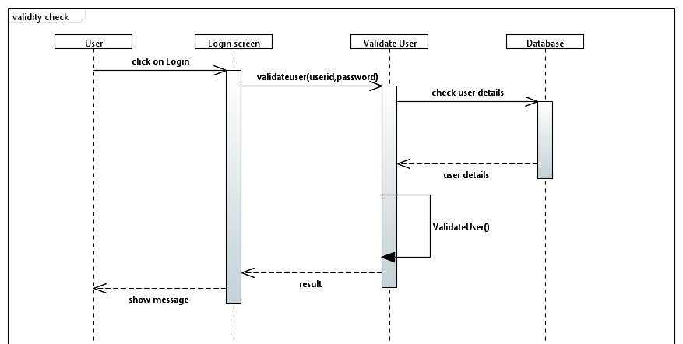
Sequence Diagram

Slide 15
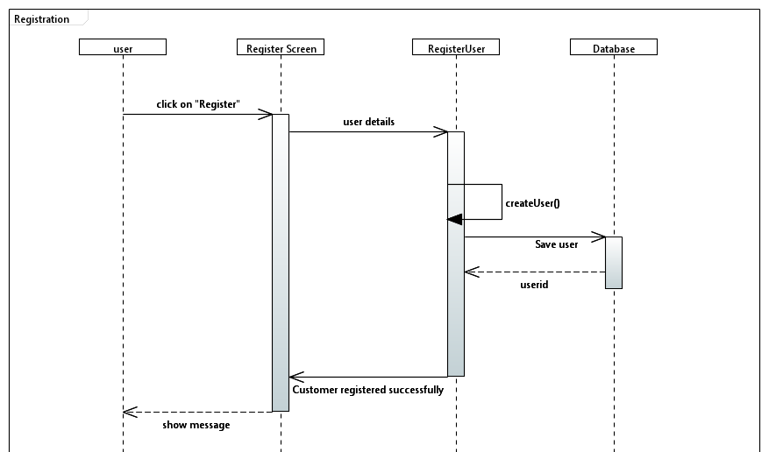
Sequence Diagram

Slide 16
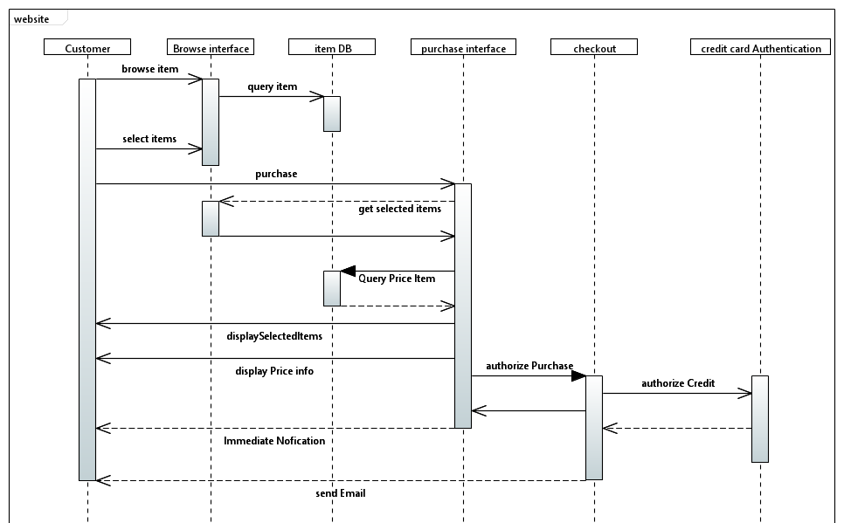
Sequence Diagram

Slide 17
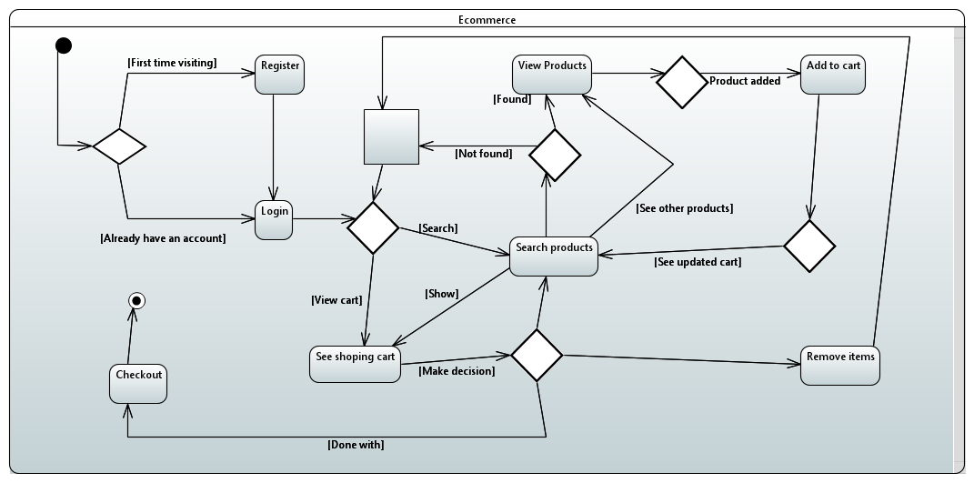
State Management

Slide 18
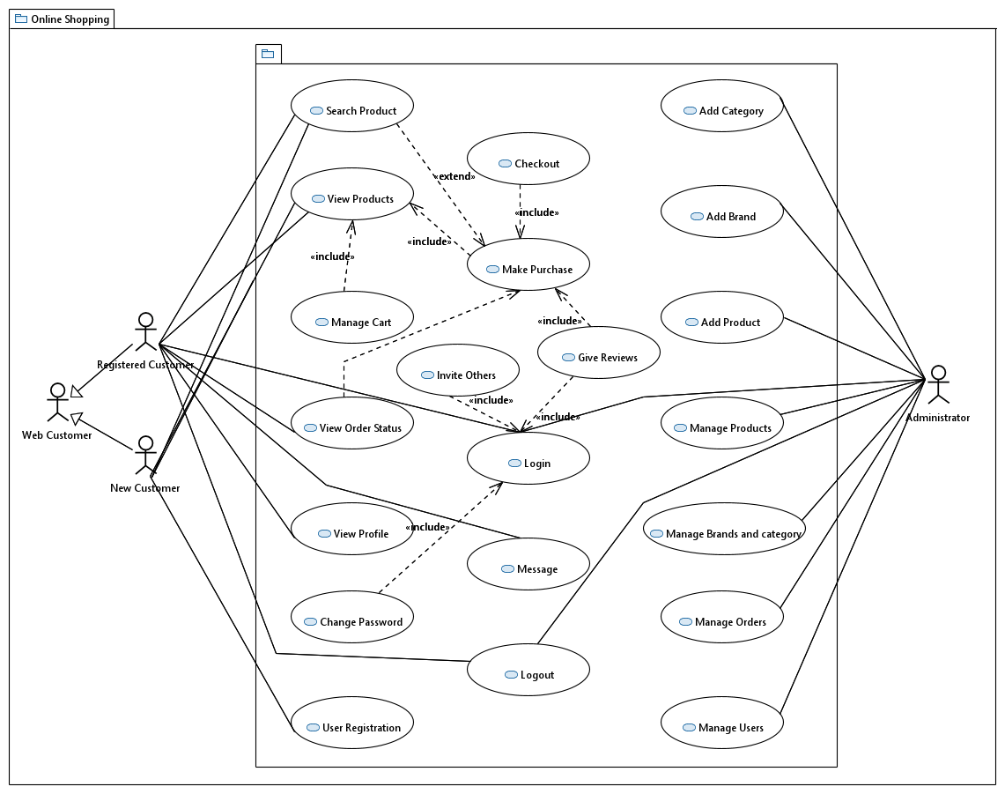
Use Case

Slide 19
Business opportunities are like buses. There’s always another one coming.
“
”
Richard Branson

Slide 20





Plan for product launch
Planning
Synergize scalable e-commerce
Marketing
Disseminate standardized metrics
Design
Coordinate e-business applications
Strategy
Foster holistically superior methodologies
Launch
Deploy strategic networks with compelling e-business needs

Slide 21

Thank you

